Slide 1

InterWorks – Case Study
Data Engineer – by Phil Baltazar

Slide 2
InterWorks – Case Study
Summary
Analyze and manipulate data.
Clean and format data, including feature engineering.
Load cleaned/sanitized data into PostgreSQL.
Create fact, dimension and view tables in PostgreSQL.
Present findings and insights through consultancy lenses.
Data Engineer – by Phil Baltazar

Slide 3
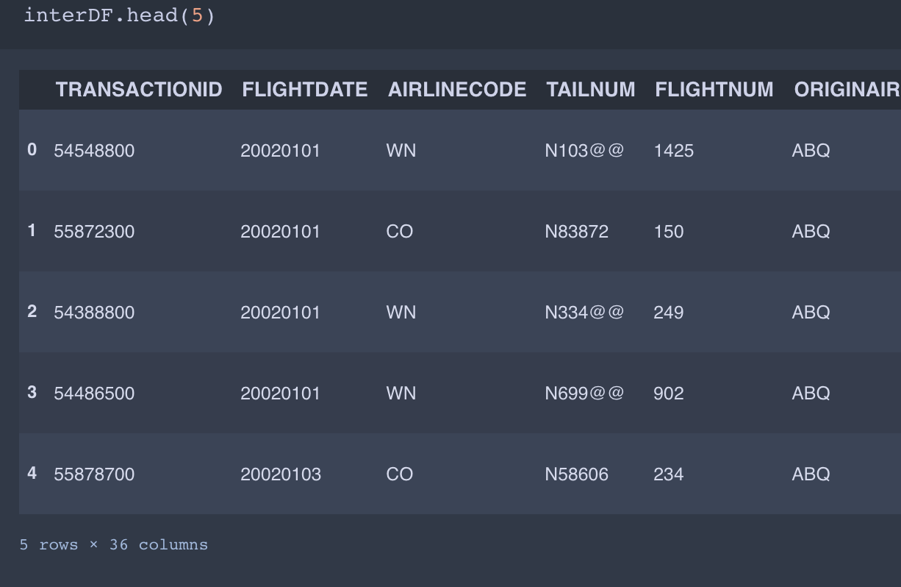
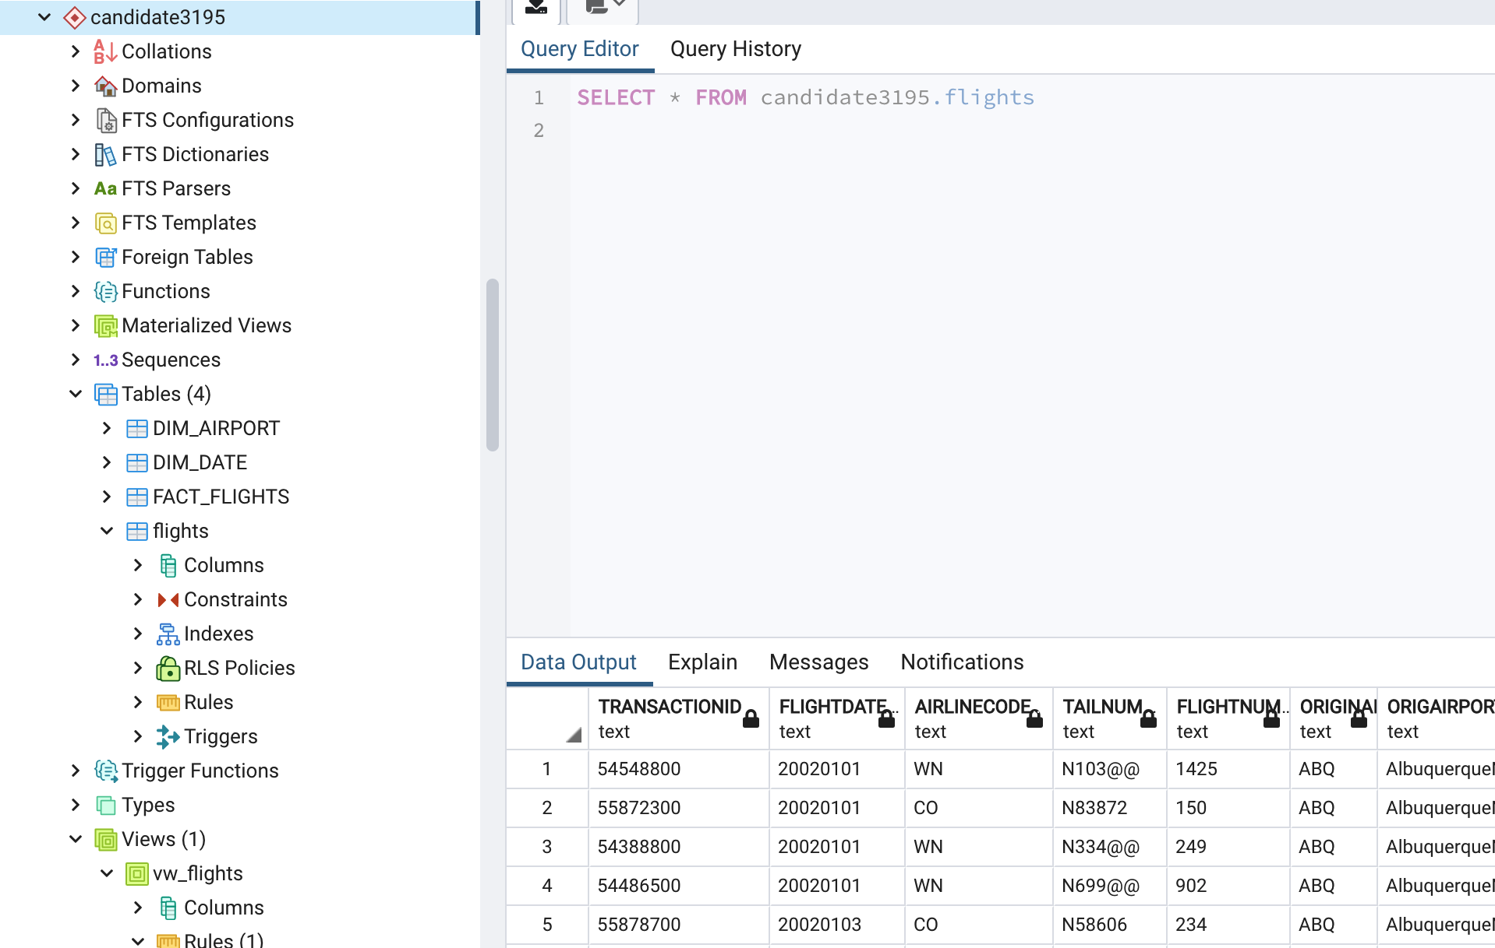
InterWorks – Case Study
After some Data Engineering, the data is clean and ready for further analysis.
Some tables were created in PostgreSQL to facilitate visualization through Tableau.
Data Engineer – by Phil Baltazar

Slide 4
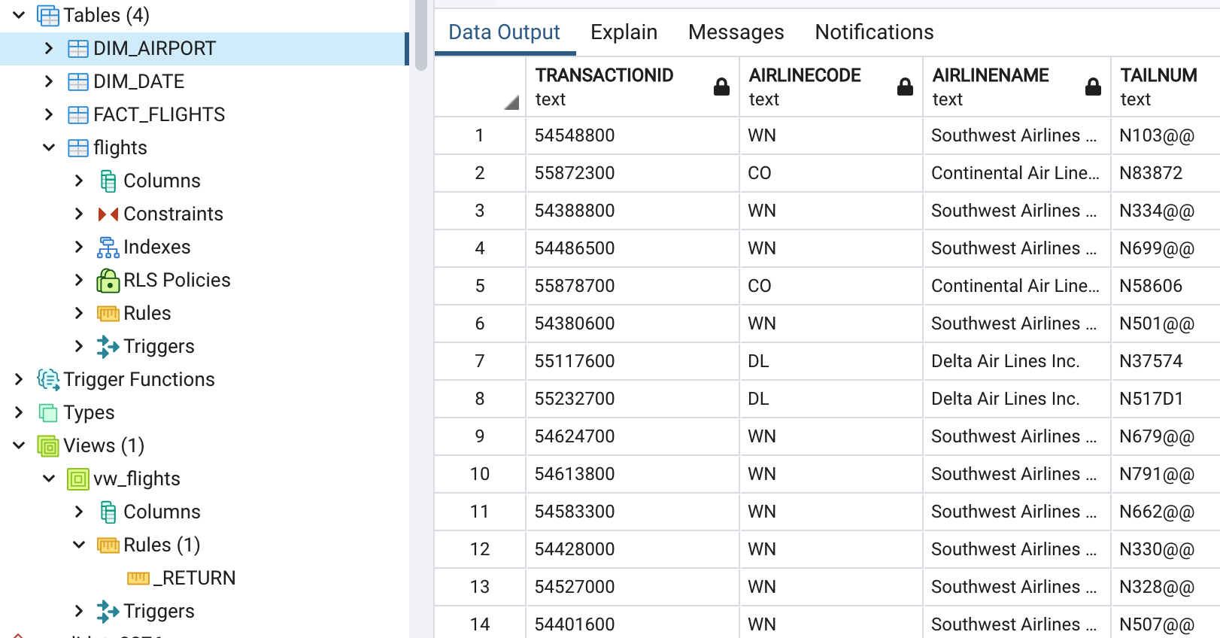
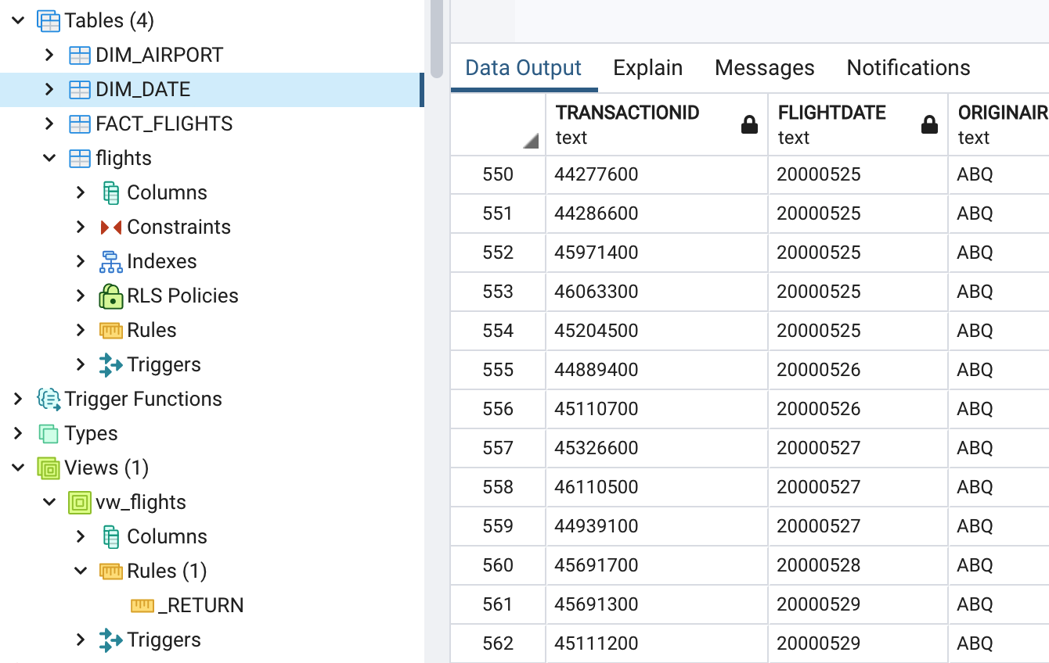
InterWorks – Case Study
Dimension Table DIM_AIRPORT could be used as a technical table that shows info about airport and aircraft.
Dimension Table DIM_DATE focuses more on dates from flights and information such as flight date and destinations.
Data Engineer – by Phil Baltazar

Slide 5
InterWorks – Case Study
DIM_AIRPORT table:
Contains more technical and mechanical attributes to support visualization for a more technical audience, or when the insights to be drawn from the data have a more technical/mechanical flare.
DIM_DATE table:
Contains information about the flight date, origin and destination (airport and cities) and other attributes to support visualizations of flights from a specific airport, or on a certain date or even which airport had the most flights from the data provided.
Flights table:
Contains TRANSACTIONID as the primary key. All other tables and views uses this value as a foreign key.
Data Engineer – by Phil Baltazar

Slide 6
InterWorks – Case Study
Data Repairs:
Those whose values were either True or False (Boolean) needed to be cleaned of many format variants (CANCELLED and DIVERTED).
Also, as recommended in the case study, AIRLINENAME was corrected to show more atomic values (removed code to another existing column, AIRLINECODE).
The column DISTANCE was manipulated to facilitate wrangling, and left untouched, although two new columns were engineered from it: DISTNUM and MEASURE. The former with just the numerical representation of miles, and the later with the measurement string, in this case “miles” as preferred in the case study document.
Fixed and optimized all data types of every attribute.
Data Engineer – by Phil Baltazar

Slide 7
InterWorks – Case Study
Data Engineering:
Aside from the columns created during repairs, these additional attributes were engineered:
DEPDELAYGT15 – which represents delays greater than 15 minutes.
DISTANCEGROUP – represents binned traveled distances into “short”, “medium” or “long”.
NEXTDAYARR – returns to True if the flight arrives on the next/following day.
Further Considerations:
Column ORIGAIRPORTNAME and DESTAIRPORTNAME remain concatenated. All columns with time are shown as integers. DEPDELAY and NEXTDAYARR could use accuracy improvement. The VW_FLIGHTS view needs a better filter either through pgAdmin4 directly or through code review in Jupyter. A second iteration would address these.
Data Engineer – by Phil Baltazar

